Slide 1


SupportGenie:AI-Powered Multi-Turn Customer Assistance
PRESENTED BY:
VARSHITHA Y
SANGHAVI Y
MANOGNA R

Slide 2
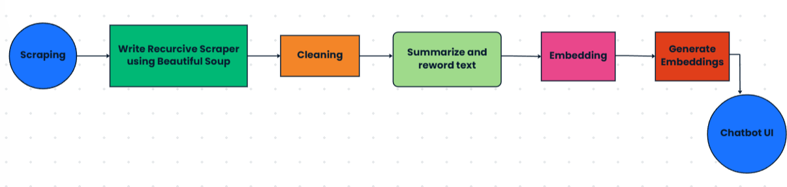
OBJECTIVE:
Develop a privacy-preserving AI chatbot using synthetic data for UMBC's ISSS.
Technology Stack:
Scraping: Requests, BeautifulSoup
Preprocessing: Regex, manual cleaning
Modeling: RAG (Retrieval-Augmented Generation)
Embedding: Sentence Transformers, FAISS
UI: Streamlit

Slide 3
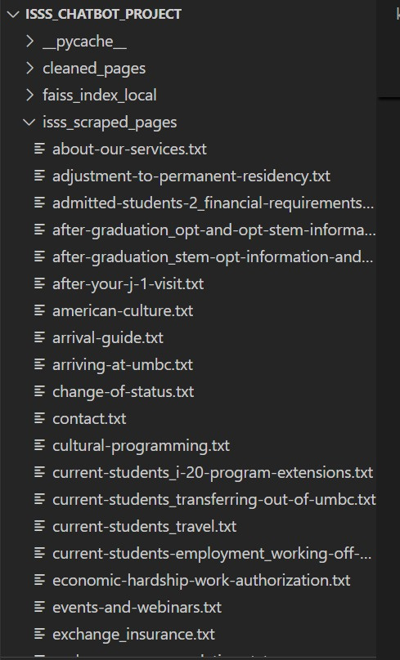
Phase I Recap: Web Scraping Pipeline
Base URL: https://isss.umbc.edu/
Tools Used: requests, BeautifulSoup
Steps Completed:
Crawled all internal links recursively
Extracted tags: <p>, <h1>, <h2>, <li>
Saved each page’s content as .txt

Slide 4
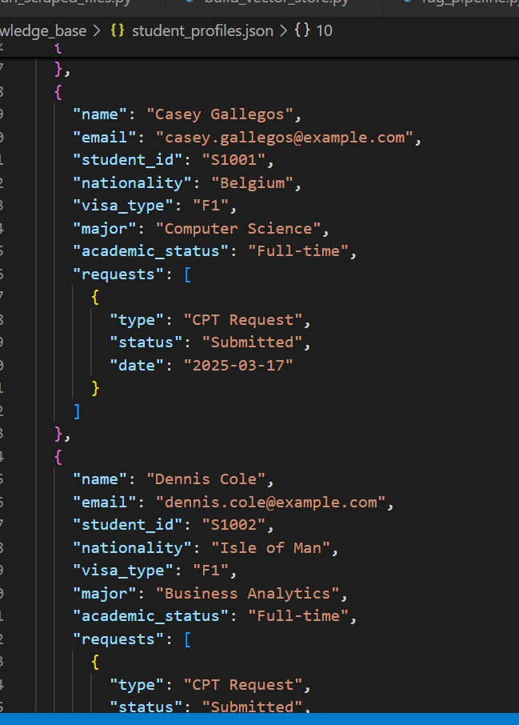
TEXT CLEANING AND SYNTHETIC DATA PREPARATION
Cleaning Process:
Removed headers, nav bars, footers
Used regex + manual inspection
Synthetic Conversion:
Reworded for privacy (no real student data)
Saved into structured folder cleaned_pages/
File Types Generated:
policies.json: Page-based clean summaries
faqs.json: Extracted Q&A pairs
student_profiles.json: Fake student data via Faker

Slide 5
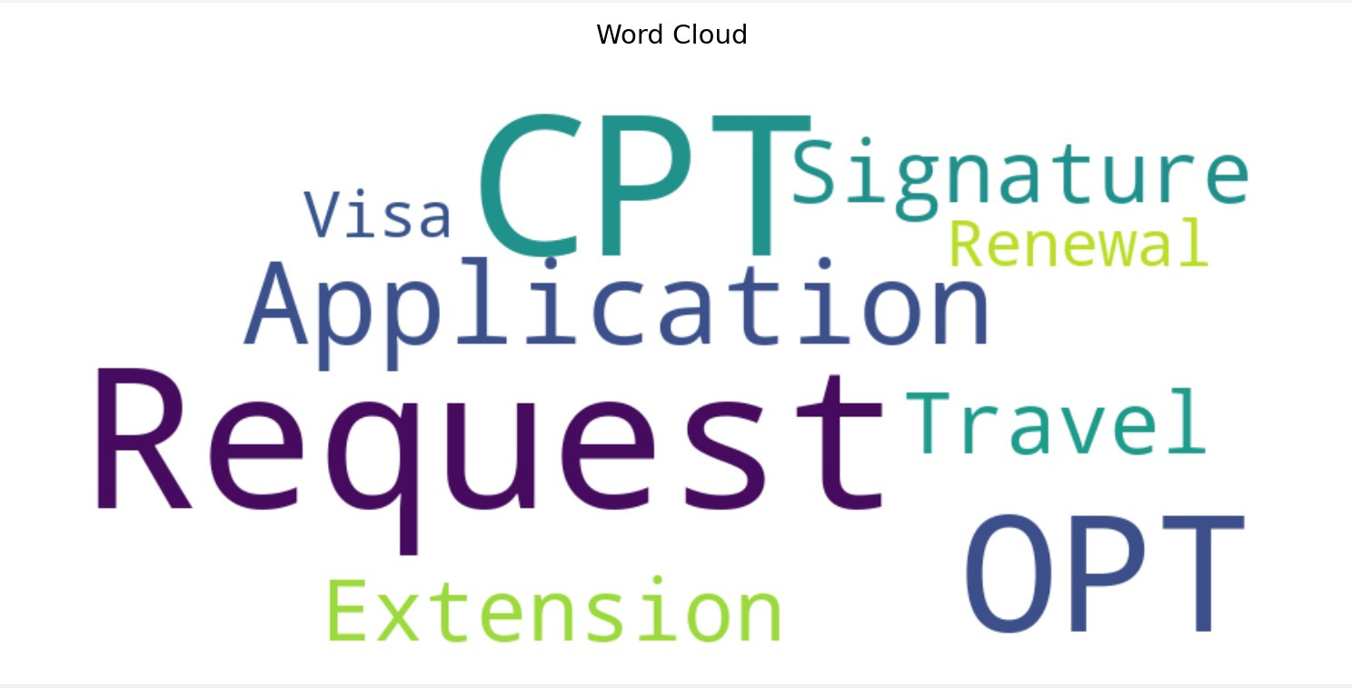
EXPLORATORY DATA ANALYSIS
Patterns Identified:
Frequent topics: OPT, I-20, SEVIS, STEM, H-1B
Common student requests categorized (admission, employment, travel)
Trends Observed:
Policies with highest content density
Most asked questions from faqs.json
EDA Tools: pandas, matplotlib

Slide 6
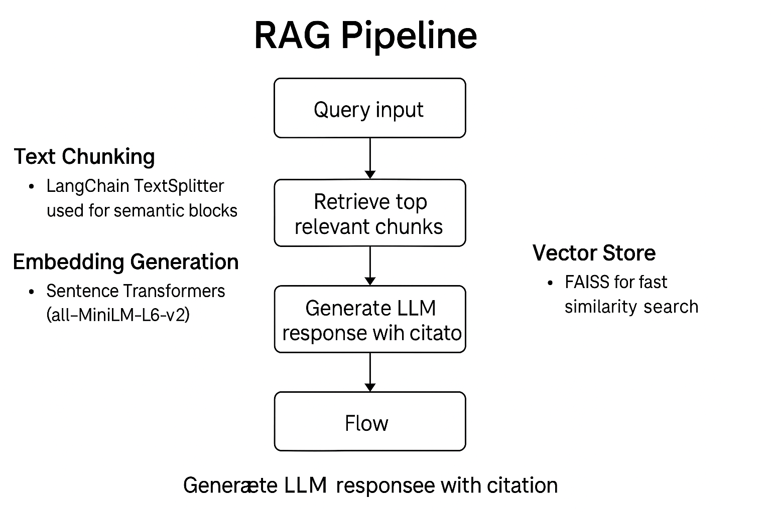
MODEL CONSTRUCTION: RAG PIPELINE

Slide 7
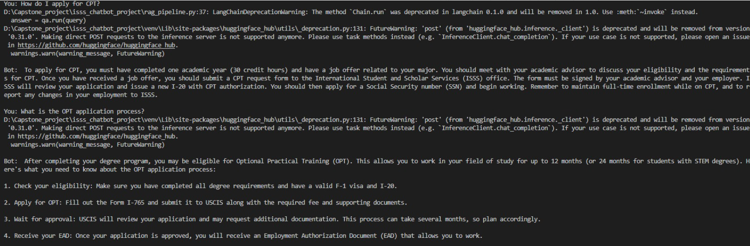
SIMULATION RESULTS:

Slide 8

CHATBOT UI AND REQUEST SIMULATION
Frontend: Streamlit chatbot interface
Synthetic Workflow Simulation:
Submit I-20
Check OPT/CPT status
Track student progress
Status updates: Based on student_profiles.json with mock logic

Slide 9
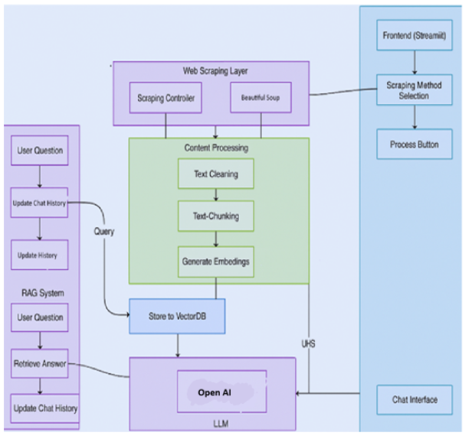
NEXT STEPS & PHASE III GOALS:
What’s Done:
Scraping, cleaning, knowledge base ready
RAG pipeline implemented and evaluated
What’s Next:
Expand synthetic dataset
Add memory to chatbot
Deploy via Streamlit
Collect user feedback
Final Goal: Deploy a scalable, privacy-preserving chatbot for ISSS

Slide 10

THANK YOU

